Slide 1
Microbiome web exploerer 620
BIONFORMATICS 620 (Spring 2014)
Snehal Talati
May 6th, 2014

Slide 2
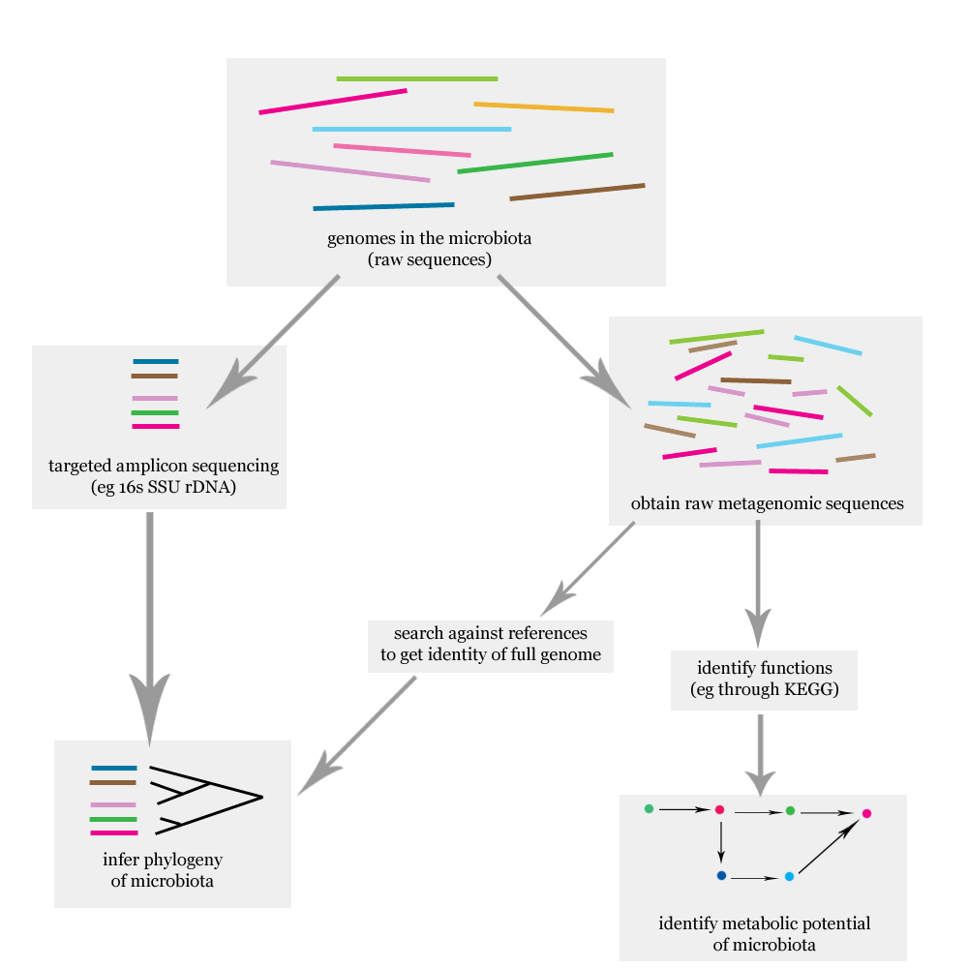
Basic Information
http://upload.wikimedia.org/wikipedia/commons/a/ac/Microbiome_analysis_flowchart.png

Slide 3
Basic Information
ORAL MICROBIOME – microorganisms that exist in the oral cavity
NGS (NEXT GENERATION SEQUENCING)- aka high-throughput sequencing which include the following technologies:
Illumina
Roche 454
Ion Torrent
SOLiD sequencing
METAGENOMICS – is based on the genomic analysis of microbial DNA that is extracted rom communities in environmental samples
CHRONIC PERIODONTITIS- is a common diesease of the oral cavity consisting of chronic inflammation of the periodontal tissues caused by the plaque

Slide 4
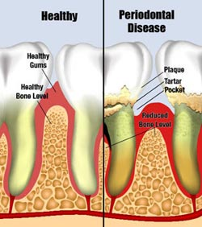
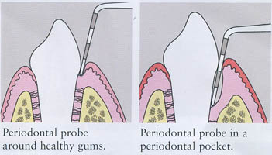
CHRONIC PERIODONTITIS
Basic Information

Slide 5
Basic Information
All human body sites colonized by the microbiota, the human microbiome
Unusually the oral microbiota is responsible for disease in most individuals
Around 90% of the population has one or more sites with gingivitis, where 10-15% is susceptible to periodontitis

Slide 6

Scope of Project
To Develop web-based Microbiome Explorer to allow searching and browsing of the analysis done by RDP-Classifier generated results and the Clinical File Mapping

Slide 7
Workflow Pipeline Diagram
Once the data is filtered through the multiple parsing scripts the files are created according to how it will be stored in the models. Once the files are created loadData scripts are generated to load the data in the django database
Once the data is obtained and parsed the data is then stored into the database. This is the BACKEND Portion of the Project
This phase will be the front end portion using DJANGO Python framework to connect the BACKEND with the FRONTEND so our users can use this web interface for our microbiome explorer

Slide 8
Data Files
OralMicrobiome_Clinical_Mapping_File
This file contained the sample file name, date, and barcode which was mapped to the Clinical Data File
Clinical Data File
This contained all the Attributes regarding each patient sample
FASTA File Directory
All patient sample files in fasta format which was used to generate the profile summary and read assignment files

Slide 9
Tools/Software Used
RDP-Classifier: to classify the patient samples based on the taxonomy
Django-Python Web Framework: to create a web interface to query on the data that is generated

Slide 10

First Step in Work Flow
From the data files we parsed the information to create tab delimited files from the data that was given.
The files that were created in table like format to link to the models that we create in django were the following:
Profile Summary
Taxonomy Table
Sample Table
Projects Table
Classification Table
Sample Attribute Table
Once the data is filtered through the multiple parsing scripts the files are created according to how it will be stored in the models. Once the files are created loadData scripts are generated to load the data in the django database

Slide 11
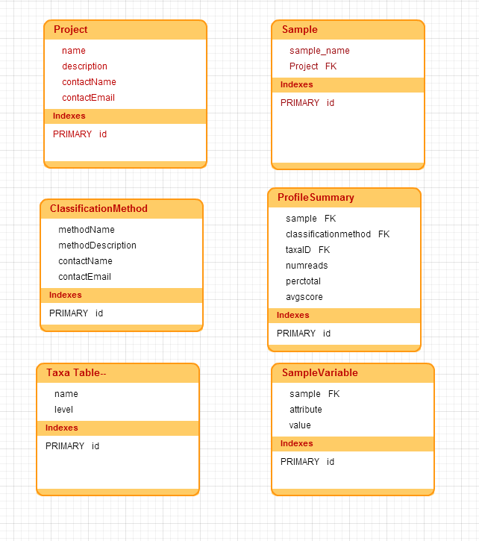
Database Design

Slide 12

Second step in Work Flow
The step after obtaining all the files in a tab delimited format was to create the models in Django accordingly. Again we have the same file names as our model names. In this step we also generated loadData scripts to load our data once our models were created
Once the data is obtained and parsed the data is then stored into the database. This is the BACKEND Portion of the Project

Slide 13
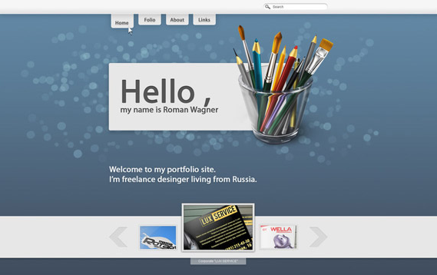
Final Step In WorkFlow
Last step was to make the forms, pages, and views to allow a user to use the data in a web based environment
This phase will be the front end portion using DJANGO Python framework to connect the BACKEND with the FRONTEND so our users can use this web interface for our microbiome explorer

Slide 14
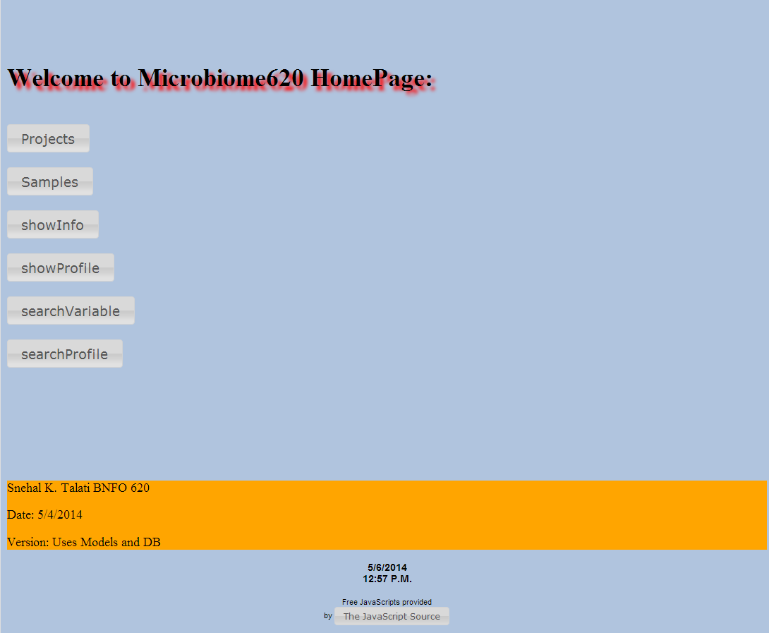
Home Page
Pages in WebExplorer and Demonstration of Application

Slide 15
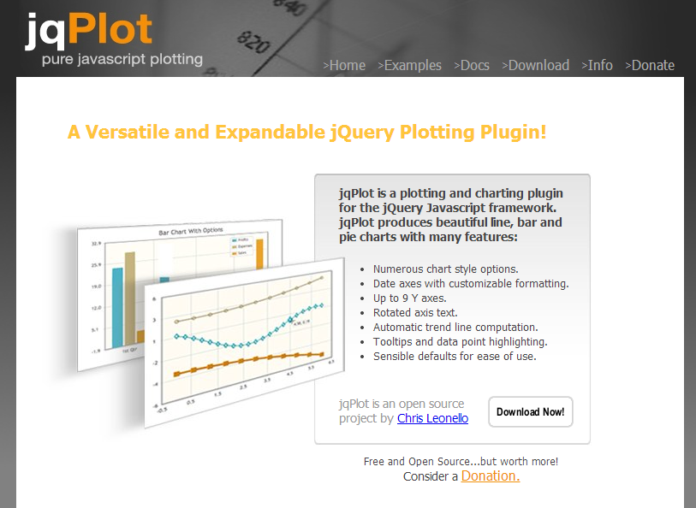
Next Step
Future Enhancements
To take this data and be able to visualize the profile summary data that we have in graphs to make better analysis.

Slide 16
What I almost did with my last computer ☺

Slide 17
Questions?
Conclusion and Remarks

